Slide 1

Collecting Chatbot for Big Data Analysis
Unlocking customer insights from chatbot conversations through data engineering and analysis.
Submit a project: Chris Winter, Victoria Vilder, Eliyahu Zinger
Date: 26/01/2025
1

Slide 2
Purpose and Objectives
Purpose
Objectives
To analyze chatbot conversations to extract actionable business insights.
Enhance customer experience by understanding their needs and pain points.
Use historical and real-time data to improve response efficiency.
Develop a robust data pipeline for collecting, cleaning, and analyzing chatbot data. Identify trends and patterns in customer interactions. Generate actionable insights for business improvement.
2

Slide 3
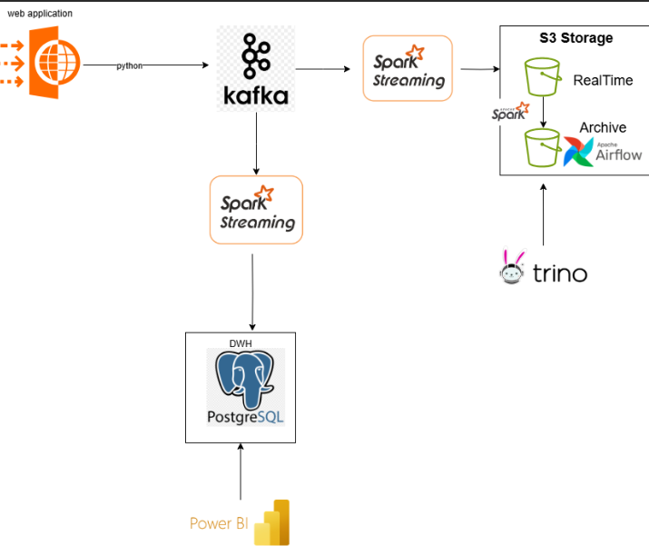
Architecture
3

Slide 4
Data Ingestion
Chosen Tool: Apache Kafka
Purpose: To handle real-time data streaming from web application, capturing JSON customer support feedback.
Alternatives:
Amazon Kinesis: A real-time data streaming service offered by AWS.
Apache Pulsar: A distributed messaging and streaming platform.
Pros of Kafka:
High Throughput: Capable of handling large volumes of data with low latency.
Scalability: Easily scales horizontally to accommodate growing data streams.
Durability: Ensures data persistence and fault tolerance.
4

Slide 5
Data Storage
Chosen Tool: S3 Storage (Parquet Files)
Purpose: To store processed data efficiently for further analysis.
Alternatives:
Hadoop Distributed File System (HDFS)
Google Cloud Storage
Pros of S3 with Parquet:
Cost-Effective: MinIO, being open-source, has no licensing costs
Scalability: MinIO is designed for high scalability, allowing for the storage of large amounts of data
6

Slide 6
Ad Hoc Querying
Chosen Tool: Trino
Purpose: To perform interactive, ad hoc SQL queries on data stored in S3, facilitating rapid insights without the need for predefined schemas or ETL processes.
Alternatives:
Amazon Athena: A serverless interactive query service provided by AWS.
Apache Drill: An open-source SQL query engine for big data exploration.
DuckDB: An open-source, in-process SQL database management system designed for efficient analytical query processing on large datasets.
Pros of Trino:
Open Source: No licensing costs, offering flexibility and community support.
High Performance: Optimized for low-latency queries across large datasets.
ANSI SQL Compliance: Supports standard SQL, simplifying query development.
7

Slide 7
DB
Chosen Tool: PostgreSQL
Purpose: Primary database for storing and managing processed customer support feedback data, ensuring data integrity and facilitating efficient retrieval for analysis and reporting
Alternatives:
MySQL: A widely-used open-source RDBMS known for its speed and reliability.
MariaDB: A fork of MySQL, designed to be highly compatible with it, offering additional features and improved performance.
MongoDB: A NoSQL database that stores data in flexible, JSON-like documents.
Pros of PostgreSQL:
An advanced, open-source relational database management system (RDBMS) known for its robustness, extensibility, and compliance with SQL standards.
PostgreSQL is designed to handle increasing workloads through both vertical and horizontal scaling strategies.
8

Slide 8
Data Processing
Chosen Tool: Apache Spark
Purpose: Streaming data processing ,read from Kafka and write it into Parquet files and DB.
Alternatives:
Apache Flink: Designed for stateful computations over data streams.
Apache Storm: A real-time computation system.
Pros of Spark:
Unified Engine: Handles both batch and stream processing.
In-Memory Computing: Enhances processing speed.
Rich API Support: Offers APIs in Java, Scala, Python, and R.
5

Slide 9
Data Visualization
Chosen Tool: Power BI
Purpose: To create interactive dashboards for visualizing aggregated customer feedback data.
Alternatives:
Tableau: A powerful data visualization tool.
Looker: A business intelligence platform.
Pros of Power BI:
User-Friendly: Intuitive interface with drag-and-drop features.
Integration: Seamlessly connects with various data sources.
Cost-Effective: Offers a free version with substantial capabilities.
9

Slide 10

Data Ingestion(Python)
1
Retrieving raw data from web application as json format
2
Send data to Kafka
4

Slide 11
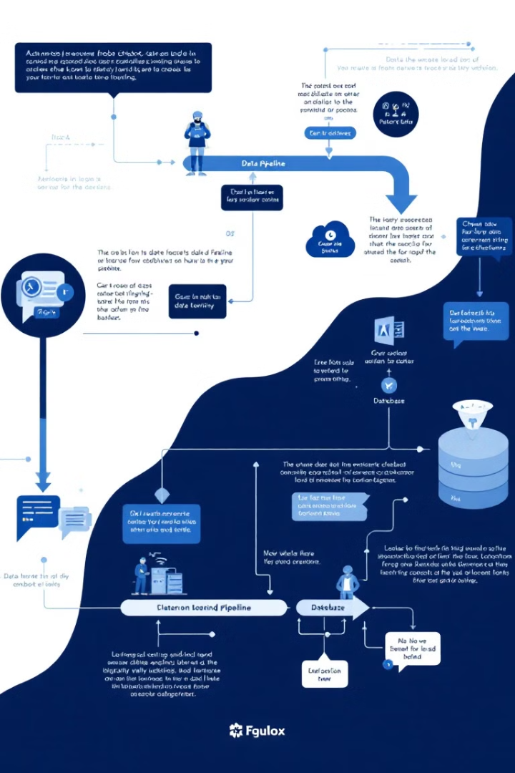
ETL Processes (Spark)
1
Extraction
Retrieving raw data from kafka.
2
Transformation
Cleaning and standardizing data for analysis, removing irrelevant information, and converting data types.
3
Loading
Storing transformed data into a relational database for efficient querying and analysis.
5

Slide 12
drop table hive.customer_issues_db.customer_issues_history
CREATE TABLE hive.customer_issues_db.customer_issues_history (
unique_id VARCHAR(255),
channel_name VARCHAR(255),
category VARCHAR(255),
sub_category VARCHAR(255),
customer_remarks VARCHAR(255),
order_id VARCHAR(255),
order_date_time VARCHAR(255),
issue_reported_at VARCHAR(255),
issue_responded VARCHAR(255),
survey_response_date VARCHAR(255),
customer_city VARCHAR(255),
product_category VARCHAR(255),
item_price VARCHAR(255),
connected_handling_time VARCHAR(255),
agent_name VARCHAR(255),
supervisor VARCHAR(255),
manager VARCHAR(255),
tenure_bucket VARCHAR(255),
agent_shift VARCHAR(255),
csat_score VARCHAR(255),
partition_date DATE
)
WITH (
format = 'PARQUET',
external_location = 's3a://history/a/'
);
select *
from hive.customer_issues_db.customer_issues_history
limit 100
Trino
Connection
Set up a connection through DBeaver
Create a table on parquet file (s3)
3

Slide 13
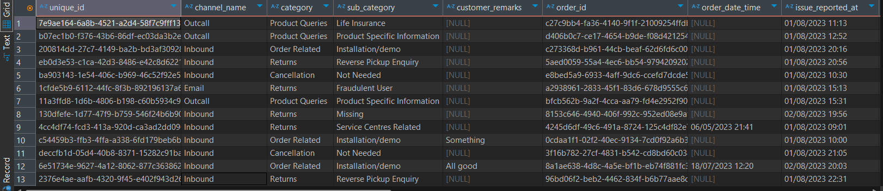
Trino Example
3

Slide 14
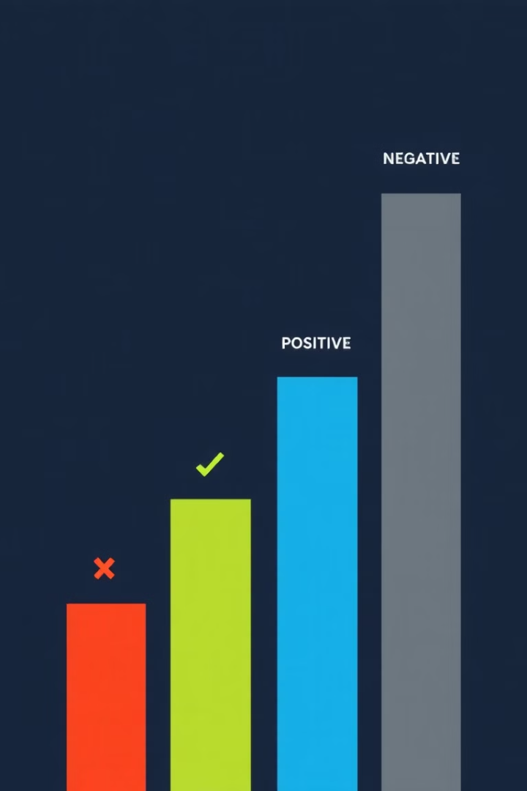
Sentiment Analysis (UDF)
Natural Language Processing (NLP)
Sentiment Scoring
Assigning numerical scores to indicate the positive, negative, or neutral sentiment of each message.
Using NLP techniques to analyze the sentiment expressed in user messages. Identify key words, phrases, and emotions.
Sentiment Trends
Tracking sentiment shifts over time, identifying potential customer satisfaction issues or positive feedback.
6

Slide 15
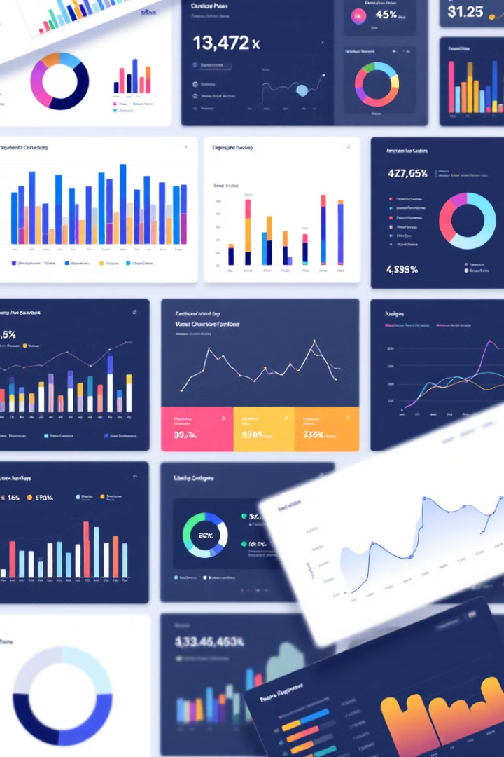
Aggregation and Insights
10,000
75%
Chats Analyzed
Positive Sentiment
Total number of conversations processed in the dataset.
Percentage of customer messages expressing positive sentiment.
15%
10%
Negative Sentiment
Neutral Sentiment
Percentage of customer messages expressing negative sentiment.
Percentage of customer messages expressing neutral sentiment.
7

Slide 16
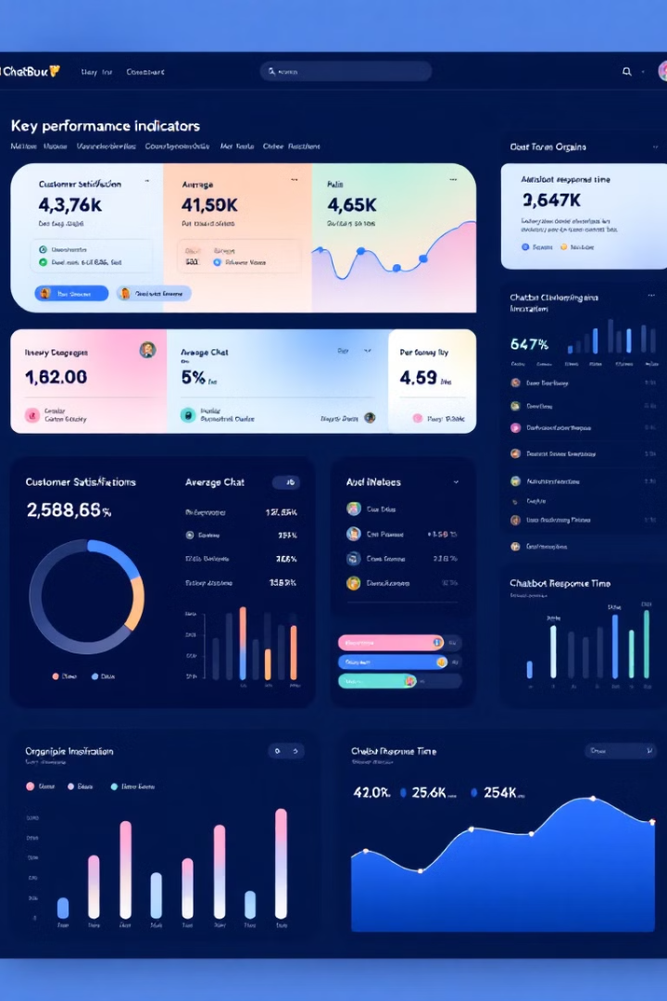



Results and Findings
Customer Satisfaction
Improved Customer Service
Analysis revealed a high level of customer satisfaction
Improve customer centers, decrease customer complaints
Data-Driven Decisions
Insights from data inform customer service strategies

